Slide 1
PRU VB Claims
E2E User Manual
RE
imagined
architected
engineered

Slide 2


Claim Journey with Gen AI
Gen AI analyses the submitted medical records to check NIGO, compare against policy certificate to recommend the claim outcome
Confirmed outcome are posed back in P360 for claim adjudication, communication & payment
QuickBase creates a case and allocate them using a controlled, rules-based pull allocation model
Claimant submitted the claim in the client’s P360 claim system
RPA BOTs scans and automatically ingest VB Claims with submitted claim information & documents
IDVS’s processes the submitted claim documents to check adequacy, classification & extraction
YOU ARE HERE
Claim Case is available for Claim Examiner to review the recommended outcome to confirm & adjudicate the claim

Slide 3

Claim Intake and Validation Process Flow - With Gen AI
LEGEND
Manual
Automation
RPA/API
QuickBase
P360, Compass
P360
2
Client
Systems
No
Change
Web/Email/Paper
submission
1
Pull Claims volume, details, documents, and existing claims from P360; Member enrollment, policy data from Compass
3
0
Create Claims in P360 with submitted claim documents
Create/Update Claims ticket in QuickBase with transaction data
Claimant
submits claim
Gen AI
IDVS with GEN AI
4
5
Refer repository (database ) of Group’s Policy Certificates
Submit policy revisions or new onboarding information (structured data)
Identify Document Types & check submission completeness
Capture Benefit Type (CI / ATB / HIP) & assess data readiness
6
7
Transform unstructured records, check mandatory info for claimed/unclaimed benefits ,coverages
Verify claims against policy certificates — policy exclusions, covered coverage, definitions, exclusions, limits, eligibility, payability
8
User reviews, modifies (if necessary), and approves the outcome
QuickBase
RPA/API
P360
9
10
P360
11
User confirms
IGO/NIGO
Close the claim ticket in QB
Update Claims in P360 with approved information
Claim Adjudicator‘s Review &
Decision
IGO
P360
P360
12
13
14
Update claims ticket for awaiting additional information, in QB
Update Claims in P360 with approved information (if applicable)
Adjudicator
sends the NIGO Communication from P360
NIGO

Slide 4

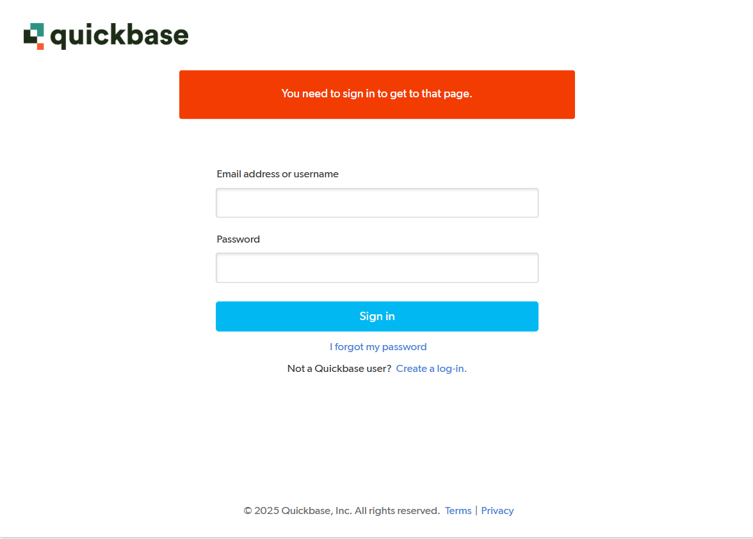

What you need to do
Log In to QuickBase:
Log in to QuickBase using your Prudential email and password to securely access the system
What the system handles in the background
The QuickBase platform uses Single Sign-On (SSO), so your Prudential credentials automatically authenticate you and provide direct access to the Claims application, and no additional login is required

Slide 5
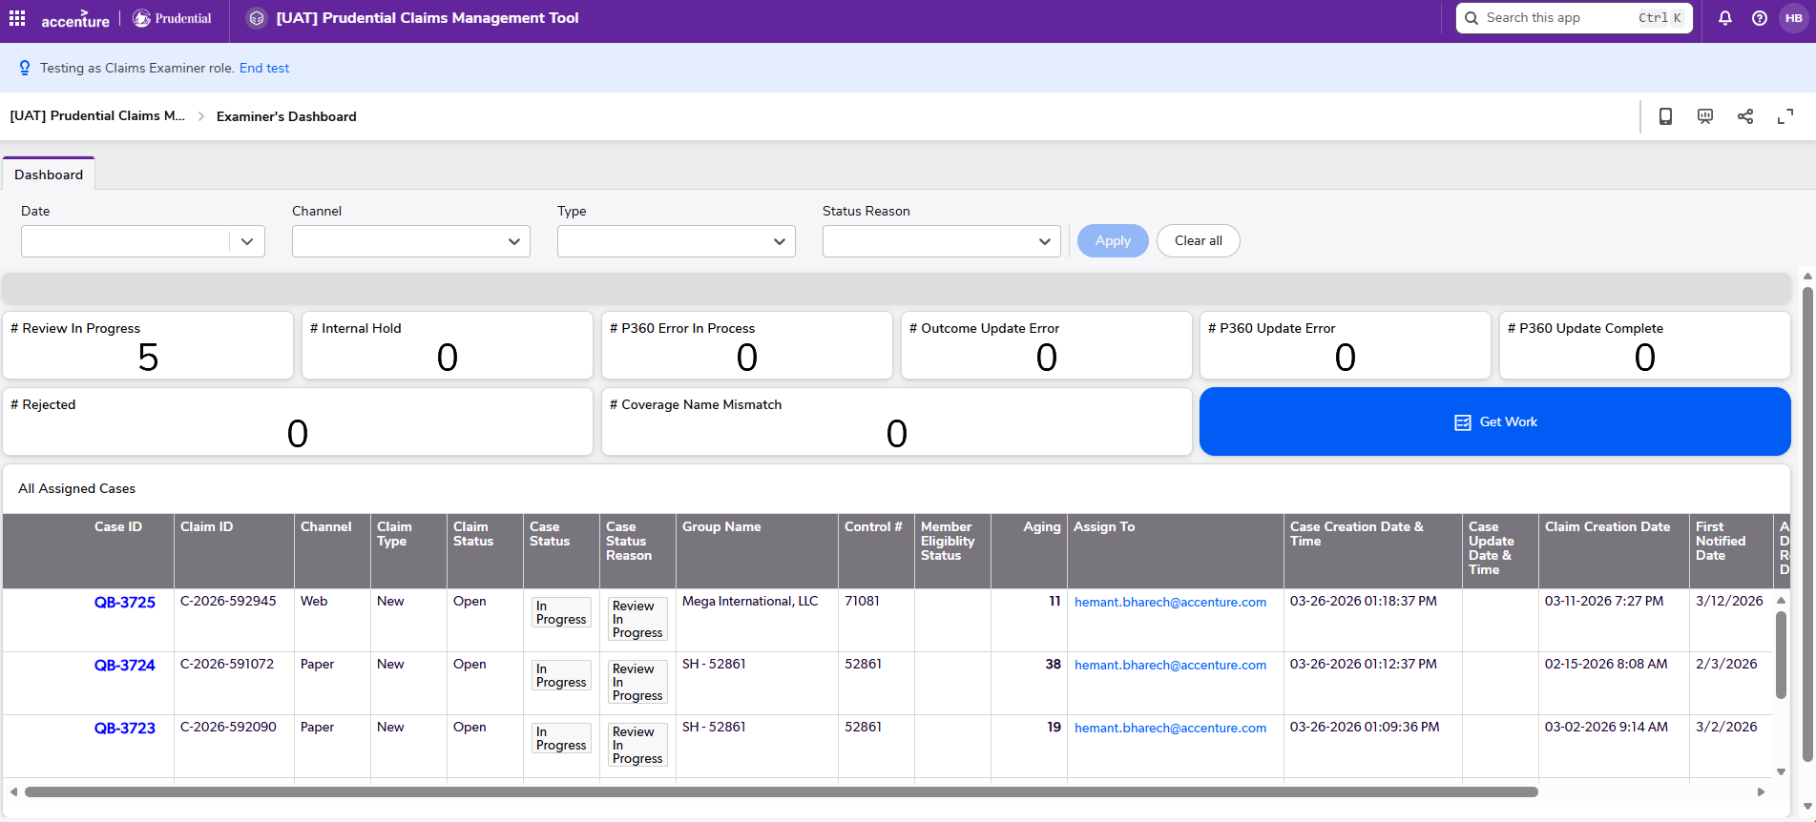
What you need to do
Access Your Action Centre & Get Work:
After logging in, you land on the Dashboard, which serves as your action center, displaying open items, the “Get Work” option, and a detailed view of cases where you can take action
To begin processing, click “Get Work”
If a case is available for you, QuickBase will directly take you into that case
If no case is available, the system will inform you accordingly
What the system handles in the background
QuickBase applies a controlled, rules-based pull allocation model to decide which case you receive
Cases are made allocation-ready and are assigned when you click Get Work, based on a rules-driven logic that considers:
Group restrictions (onshore/offshore routing)
Examiner priorities (group, product, channel)
Product mapping and appeal handling configurations
Aging, with FIFO applied within the same aging bucket to ensure the right cases are assigned in the correct order

Slide 6
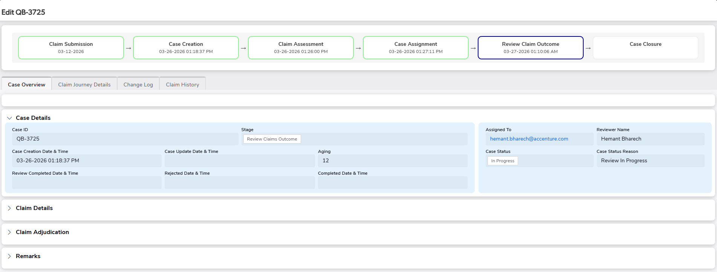
What you need to do
Access Claim Case:
In the Claim Case assigned to you, you will be able to see:
The case stages, with all completed stages marked and the current stage “Review Claim Outcome” shown as In Progress.
Key claim information under the Case Overview section, including case & claim details
Click on the “Claim Details”
What the system handles in the background
The claimant submitted the claim in the Claims System, which was captured by our system along with the claim information & submitted documents
A Claim Case was created in QuickBase for the claim to track progress & assignment
The submitted documents are reviewed for adequacy, classified, and the key information is extracted for validation
The medical records are reviewed against the policy certificate to identify any missing information and to recommend the appropriate claim outcome
Once a case is “review ready” it is then assigned to you based on the configured allocation rules

Slide 7
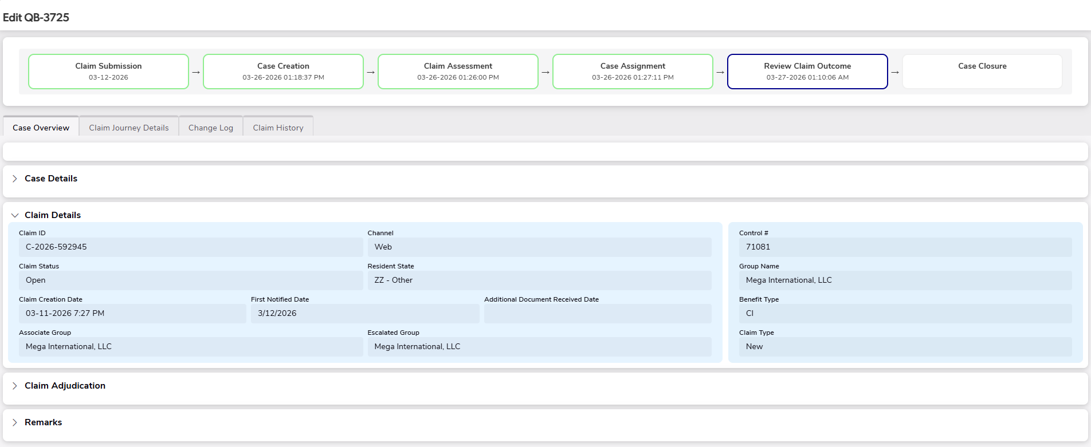
What the system handles in the background
Once the case is assigned to you, the case status is updated from Ready for Review to Review in Progress; system starts tracking your handling time for the review at this point
To avoid overlaps or incorrect handling time calculations, the system ensures that you can have only one case in Review in Progress at a time
However, multiple cases may appear under this status in your name if a Team Lead assigns/reassigns a case for urgent review or if a previously on-hold case is moved back to Review in Progress after 24 hours for your action
What you need to do
Access Claim Case:
In the Claim Case assigned to you, you will be able to see:
The claim details submitted by the claimant
Click on the “Claim Triage & Adjudicate” to access the embedded link and open the claim review screen

Slide 8
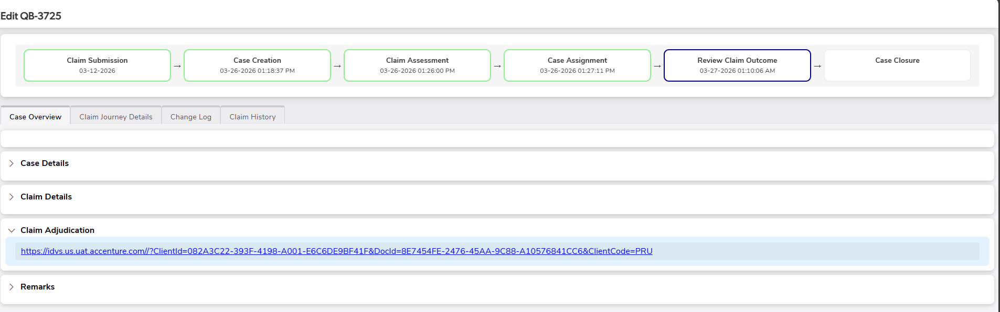
What you need to do
Access Claim Case:
Click on the link to access the “Claim Assessment” page and review the recommended outcome.
What the system handles in the background
Once the system completes its assessment and generates the recommended outcome, it provides a direct link so you can access the review screen seamlessly without navigating across multiple systems

Slide 9
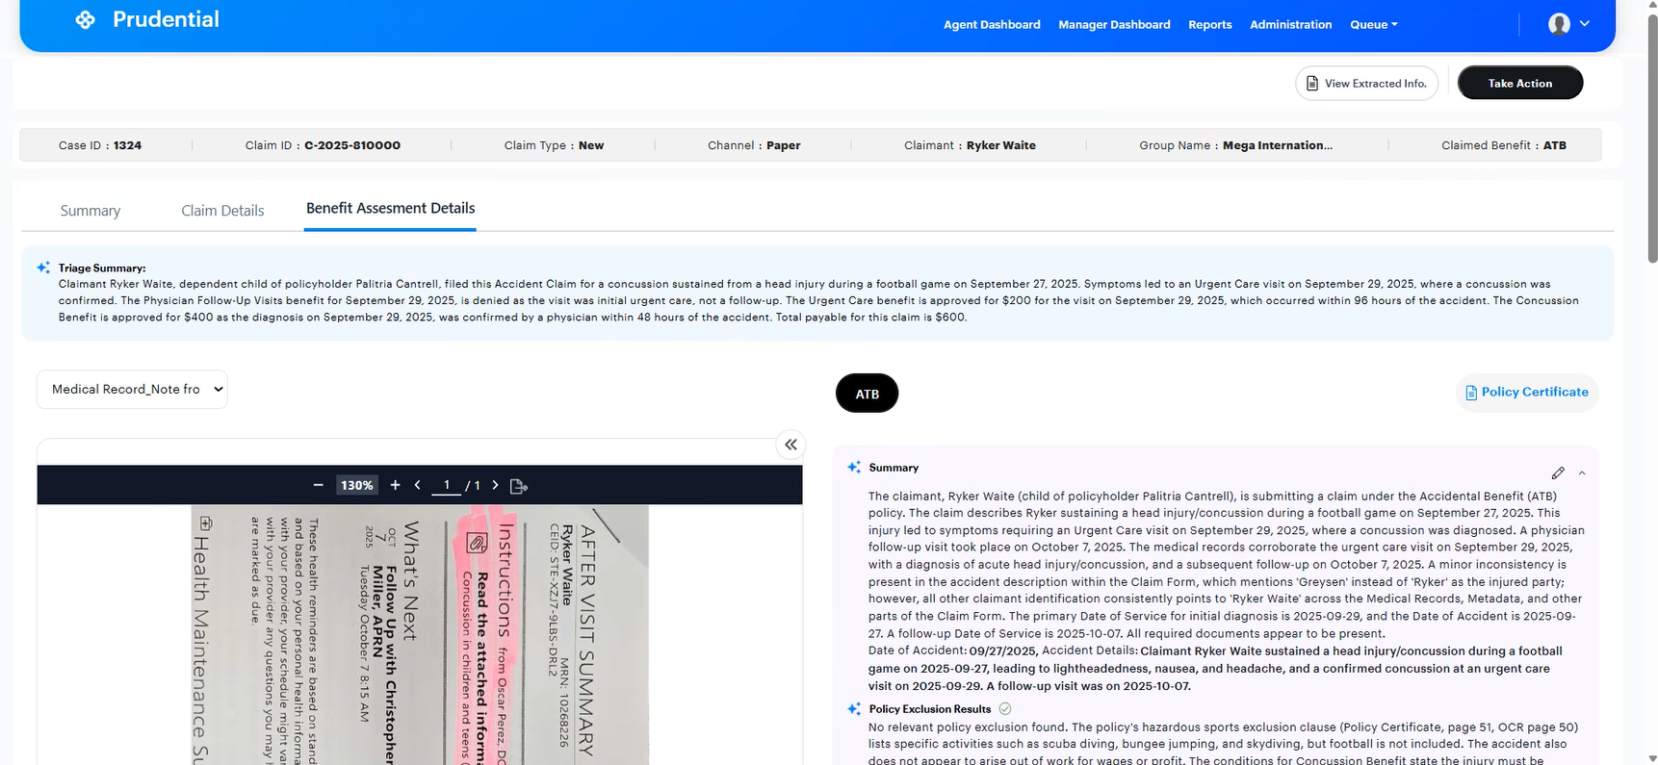
What you need to do
Review the Claim Result:
In the ‘Benefit Assessment Details’ tab, you will be able to:
Review the complete triage outcome across benefits & coverages
Review the key information extracted from the medical records, including hospitalization dates, discharge dates, diagnosis details, reason for visit, and any policy exclusions identified
Refer the medical records & policy certificate used for assessment
Update any missing medical-record details and regenerate the benefit assessment
Click ‘Scroll’ to browse through ‘Coverage Outcome’
What the system handles in the background
The system reads the submitted medical records, identifies key clinical and policy-relevant information, compares it with the applicable certificate, and presents a clear benefit-level assessment for your review.
If you make any edits to the extracted information or explanation, the system instantly regenerates the assessment

Slide 10
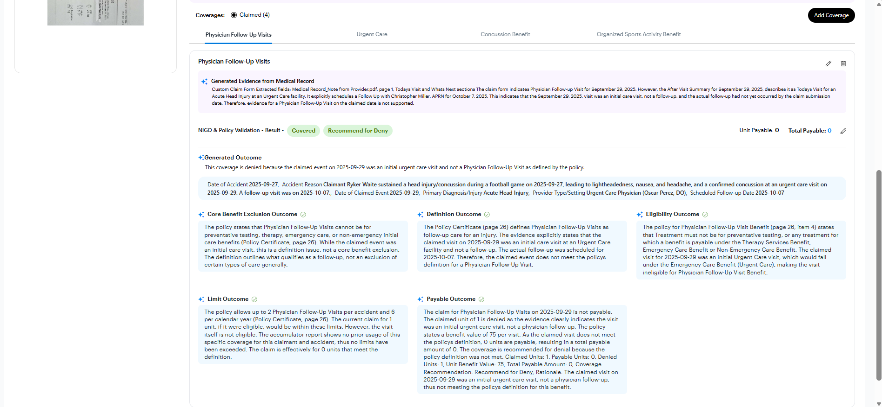
What you need to do
Review the Claim Result:
Review the outcome for both claimed and unclaimed coverages (from medical records)
For each Coverage, review key information considered, detailed assessment (includes exclusions, Definition criteria, Eligibility, Limits & Payability checks)
Review the system’s recommended outcome (Approve, Deny, or NIGO Pending) and, if required, override the outcome, payable units, or payable amount based on your review
Update any missing medical-record-based details and regenerate the Coverage assessment
Click ‘Scroll’ to move up to the ‘Take Action’ button
What the system handles in the background
The system identifies both claimed coverages (from the claim form, claim system) and unclaimed coverages (from the medical records)
For each coverage, it evaluates the medical record evidence against the policy requirements to prepare a recommendation
When you update any missing medical-record details, the system instantly regenerates the assessment

Slide 11
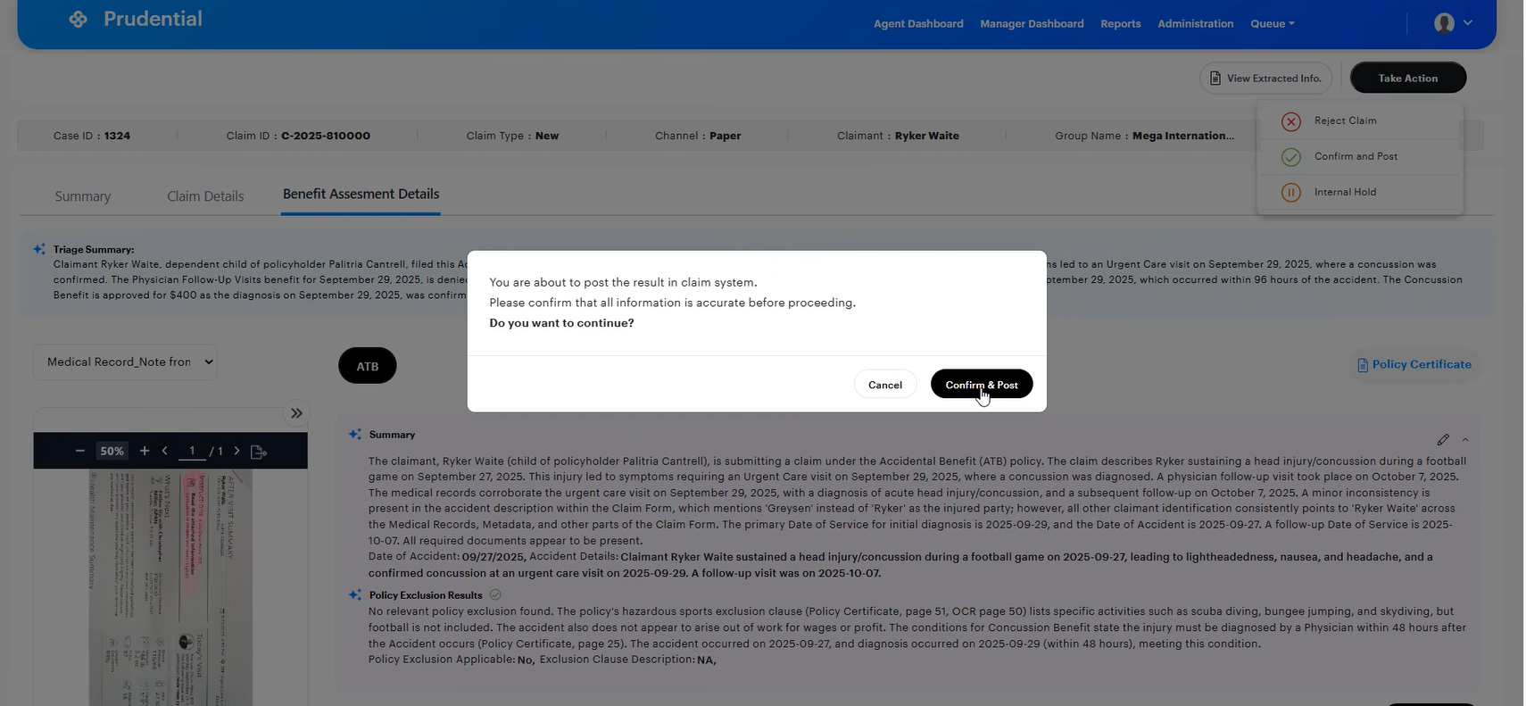
What you need to do
Review the Claim Result:
On the Take Action section, choose how you want to proceed with the claim:
Reject Claim: If you prefer to manually handle the claim outside the automated workflow
Put on Hold: If you need time to consult with the clinical team or peers before deciding
Confirm & Post Outcome: if you are ready to finalize the claim outcome and post results to the claim system
Click ‘Confirm & Post’ in the pop up to complete the review
What the system handles in the background
Rejected Claims are not tracked within the automated process
On-Hold Claims stays active, but your handling-time tracking is paused until you resume the review
For Confirmed claims, the system considers review is completed, sends the outcome to both the workflow and the client’s claim system in the background

